Slide 1

Solutions
Gary Hutson – Senior Data Scientist and NHS-R Senior Fellow

Slide 2

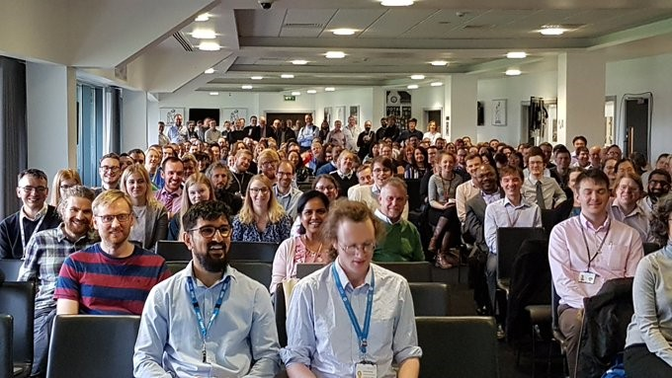

Solution Aim
As part of NHS-R Community’s aim to support the learning, application and exploitation of R in the NHS, NHS-R provides funding to ‘Solutions’.

Slide 3
What do we have?
NHSDataDictionaRy – a package to scrape common NHS lookups and perform custom web scraping
FunnelPlotR – a funnel plot package with a standard interface to generate funnel plots
Shiny EndomineR (WIP) – a Shiny tool to interface with the EndomineR package, with the aim to extract as much information as possible from semi structured endoscopy reports
Patient Feedback NHS text classification (WIP) – text classification model to deal with all the patient notes out there
Phsmethods R package expansion (WIP)

Slide 4

Solution In Focus - NHSDataDictionaRy
Commissioned by the NHS-R Community in late 2020
Provides functionality to perform web scraping and retrieve NHS lookups with ease
Always up to date and current
Recently part of an NHS-R workshop to show how to use the tool – refer to workshop section on YouTube

Slide 5
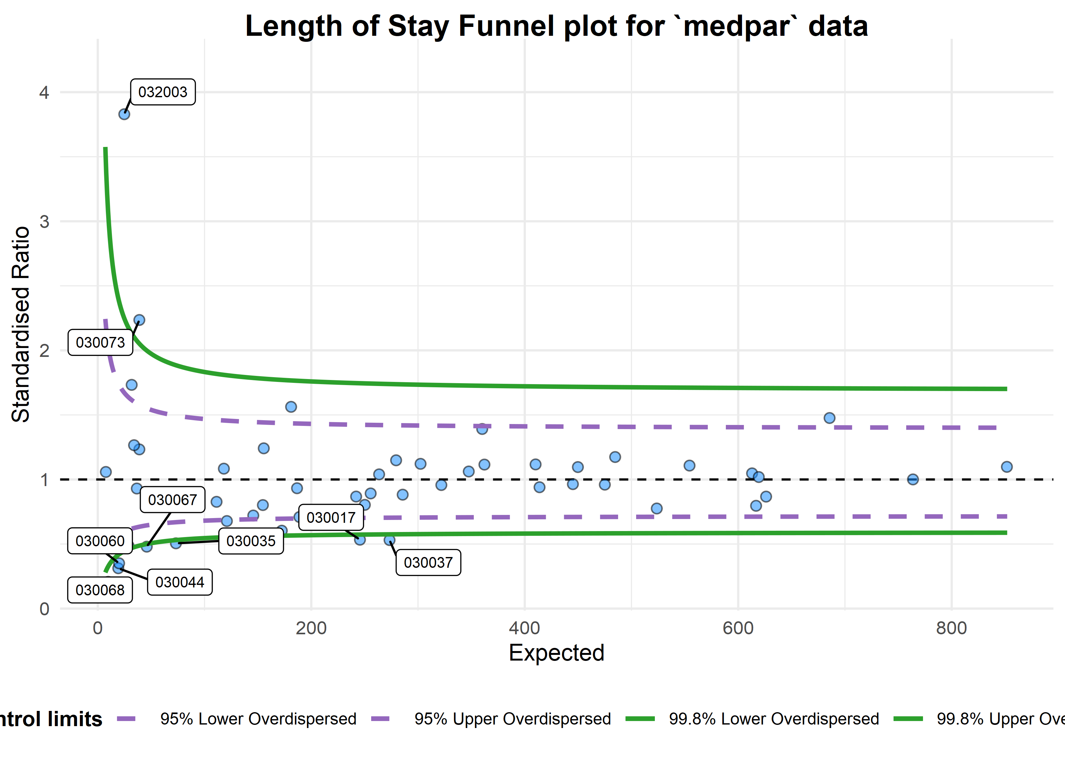
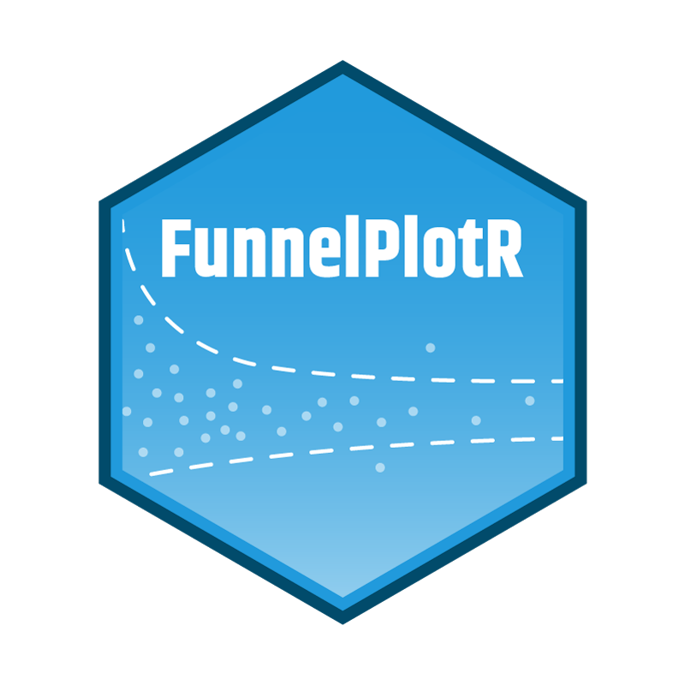
Solution In Focus – FunnelPlotR (WIP)

Slide 6
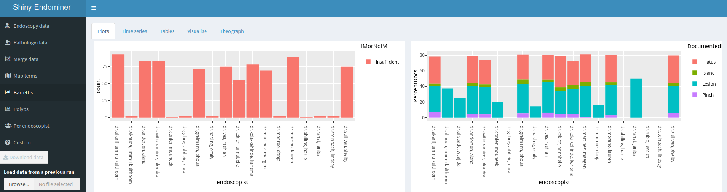

Solution In Focus – ShinyEndoMineR (WIP)

Slide 7
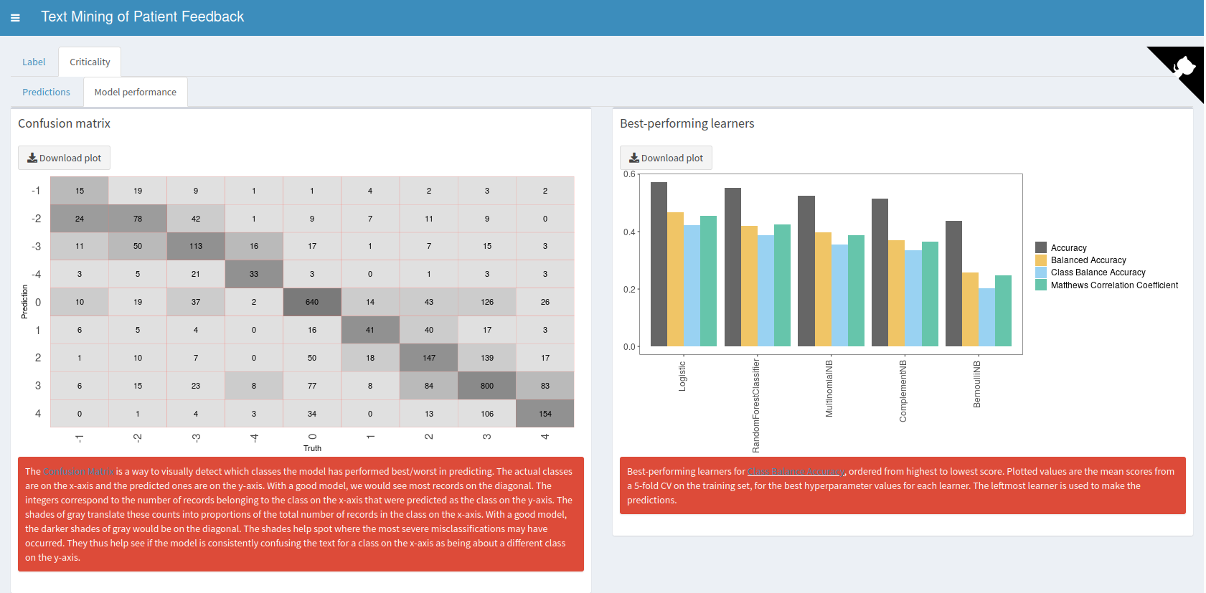
Solution In Focus – pxtextmineR (WIP)

Slide 8
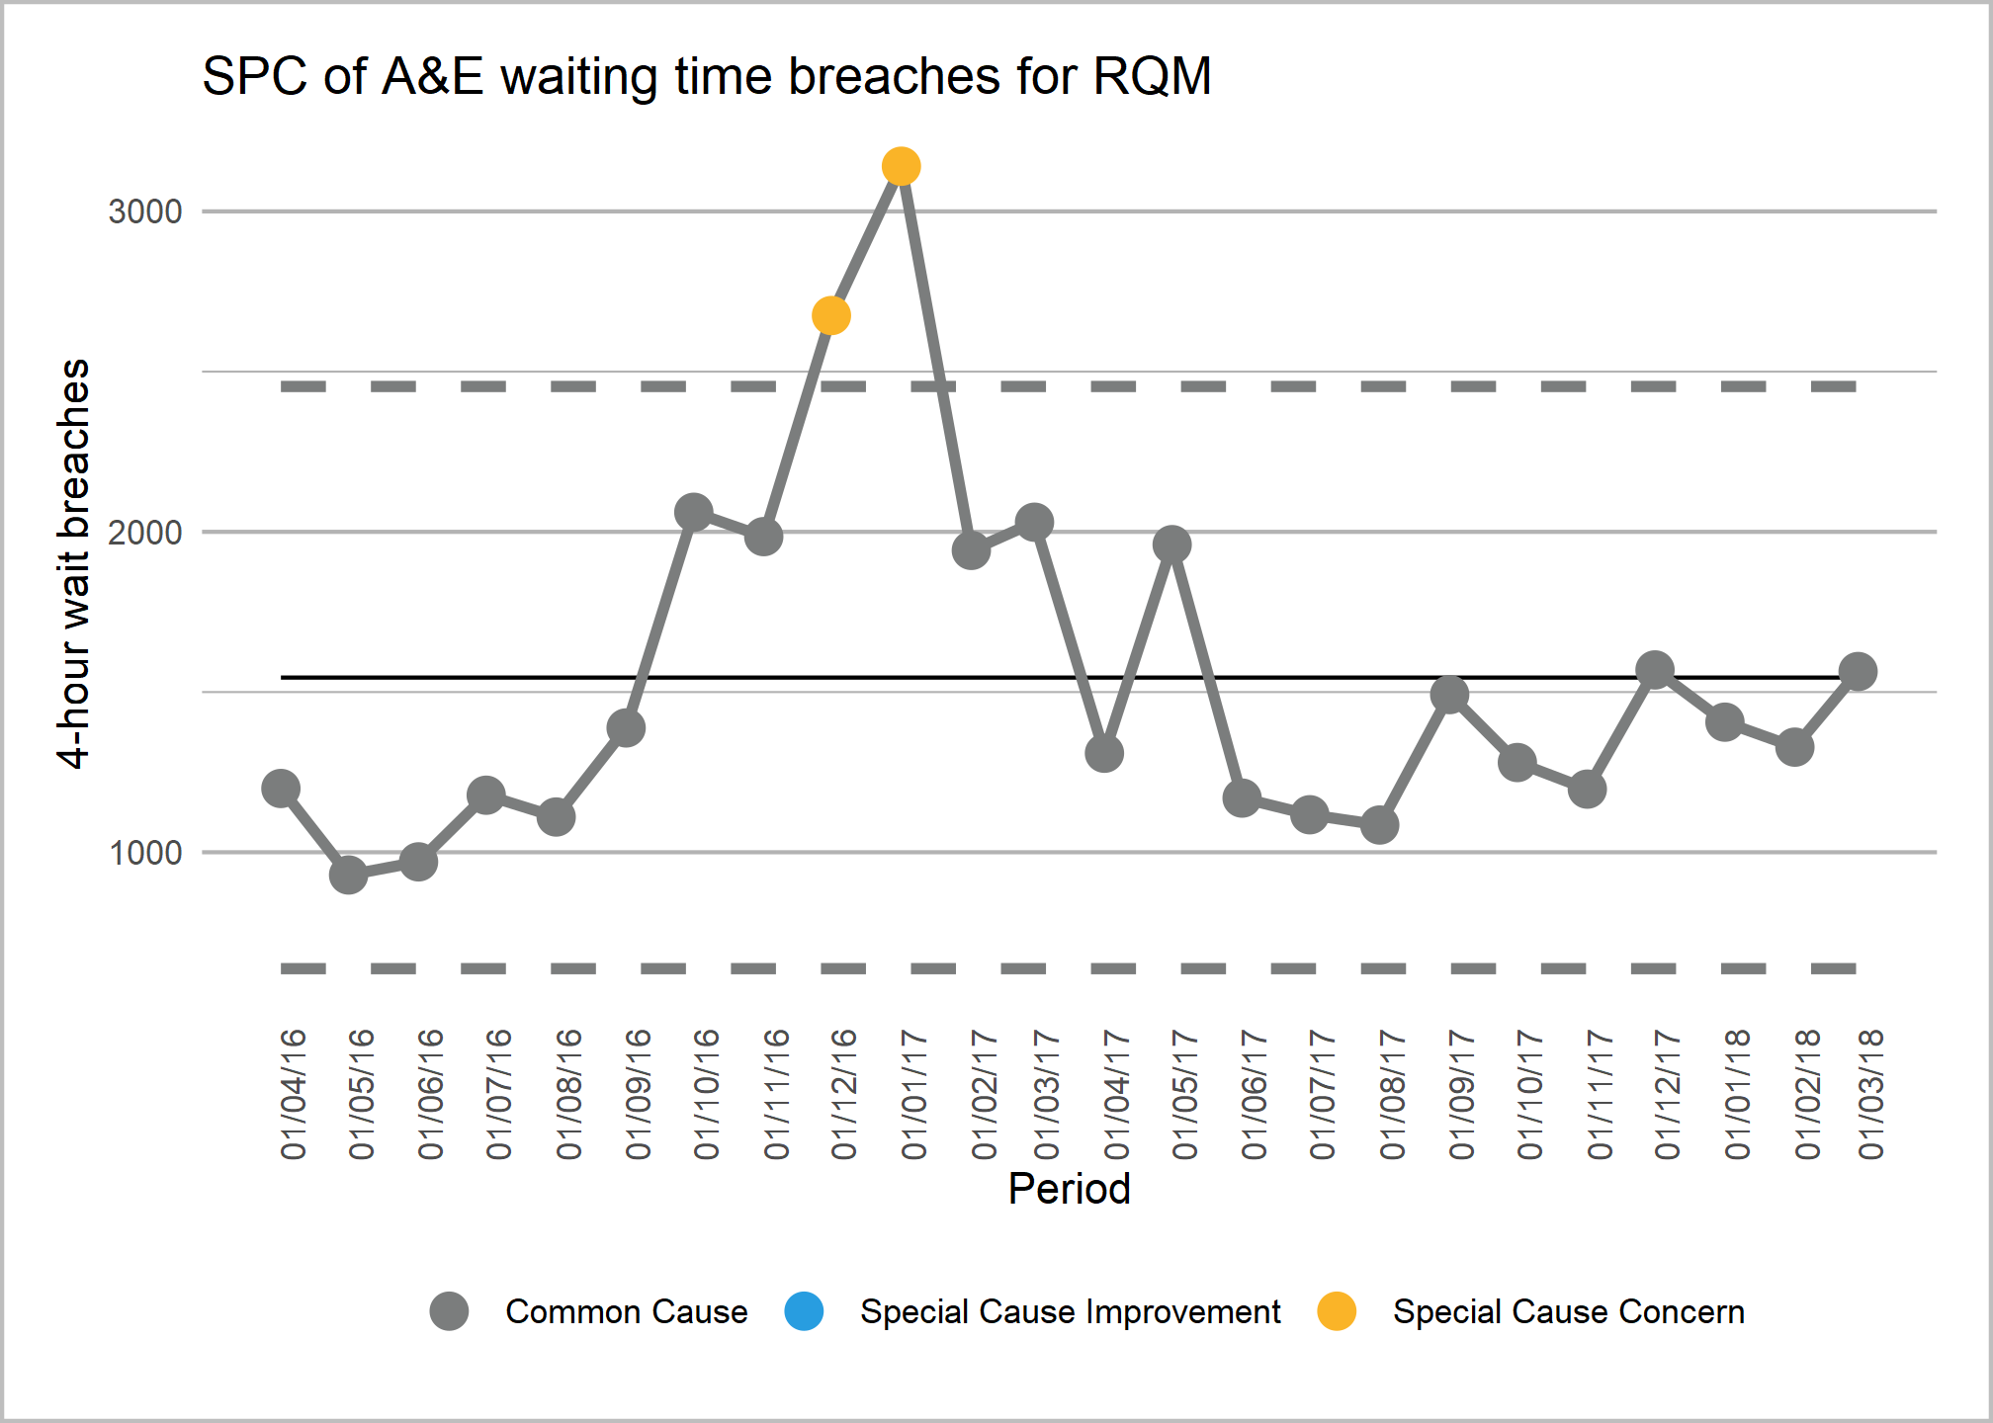
Solution In Focus – NHSRplotthedots

Slide 9
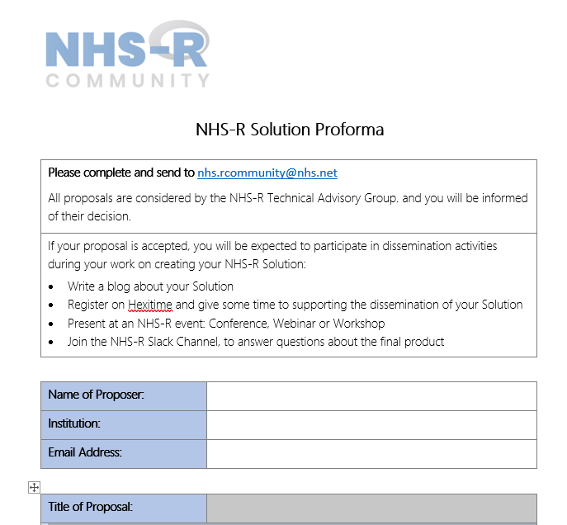
Applying to build a package or create a solution
Solutions do not need to be packages, they can be training offerings as well , such as Shiny Training, Markdown training, etc.
We are happy to receive preliminary enquiries, support the development of ideas and the people who identify a potential solution DO NOT have to be the same people to address it. The first step is identifying the solution,.
What we ask from you?
Write a blog about your solution
Register on Hexitime
Run a webinar, present at the conference or organise a workshop
Join the NHS-R Slack channel and be technical support for the package
Notes:
POINTS
that we are very happy to receive preliminary inquires, support the development of ideas, and people who identify a potential solution do NOT have to be the same people who address it.
Identifying a potential solution is the first key step.

Slide 10

What to put in your proposal?
Name, organisation, title and summary of proposal
Why you think it is a good candidate for an NHS-R funded package?
What will be required to develop the solution to be released on CRAN
Solutions released with Open Code and an appropriate licence https://choosealicense.com/
Work estimate and days to develop solutions – normally capped at 15 days max
Dependencies to deliver, such as people, resource, etc.

Slide 11

Process of getting package approval
Submission of form
Technical Advisory Group Rubber Stamps
Notification sent

Slide 12
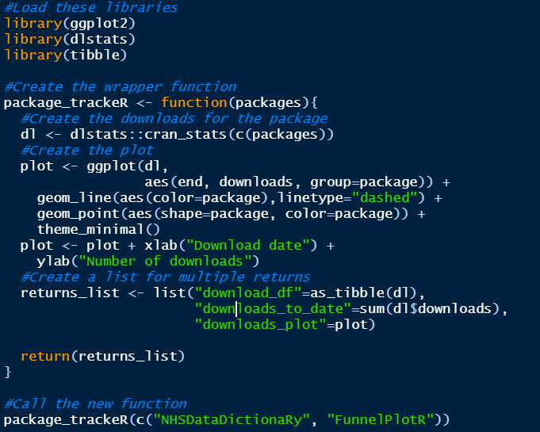
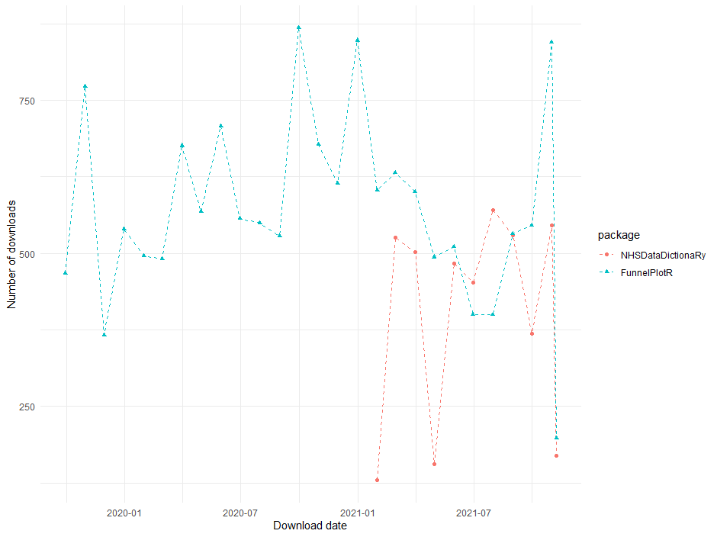
How we track our solutions, in R of course…

Slide 13
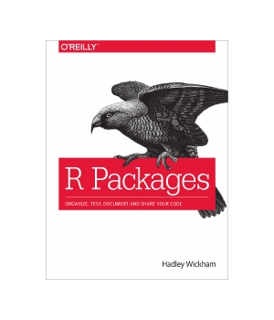

Good references for getting started with package development
Without a doubt the best reference for building R packages: https://r-pkgs.org/
Why and how to build an R package: https://www.youtube.com/watch?v=qmTaAIEXxSQ – Chris Mainey’s webinar for NHS-R community
Building R packages: https://bookdown.org/rdpeng/RProgDA/building-r-packages.html
Come along and ask the team on Slack to contribute – this is how the NHS-R plotthedots and NHSRdatasets packages arose

Slide 14
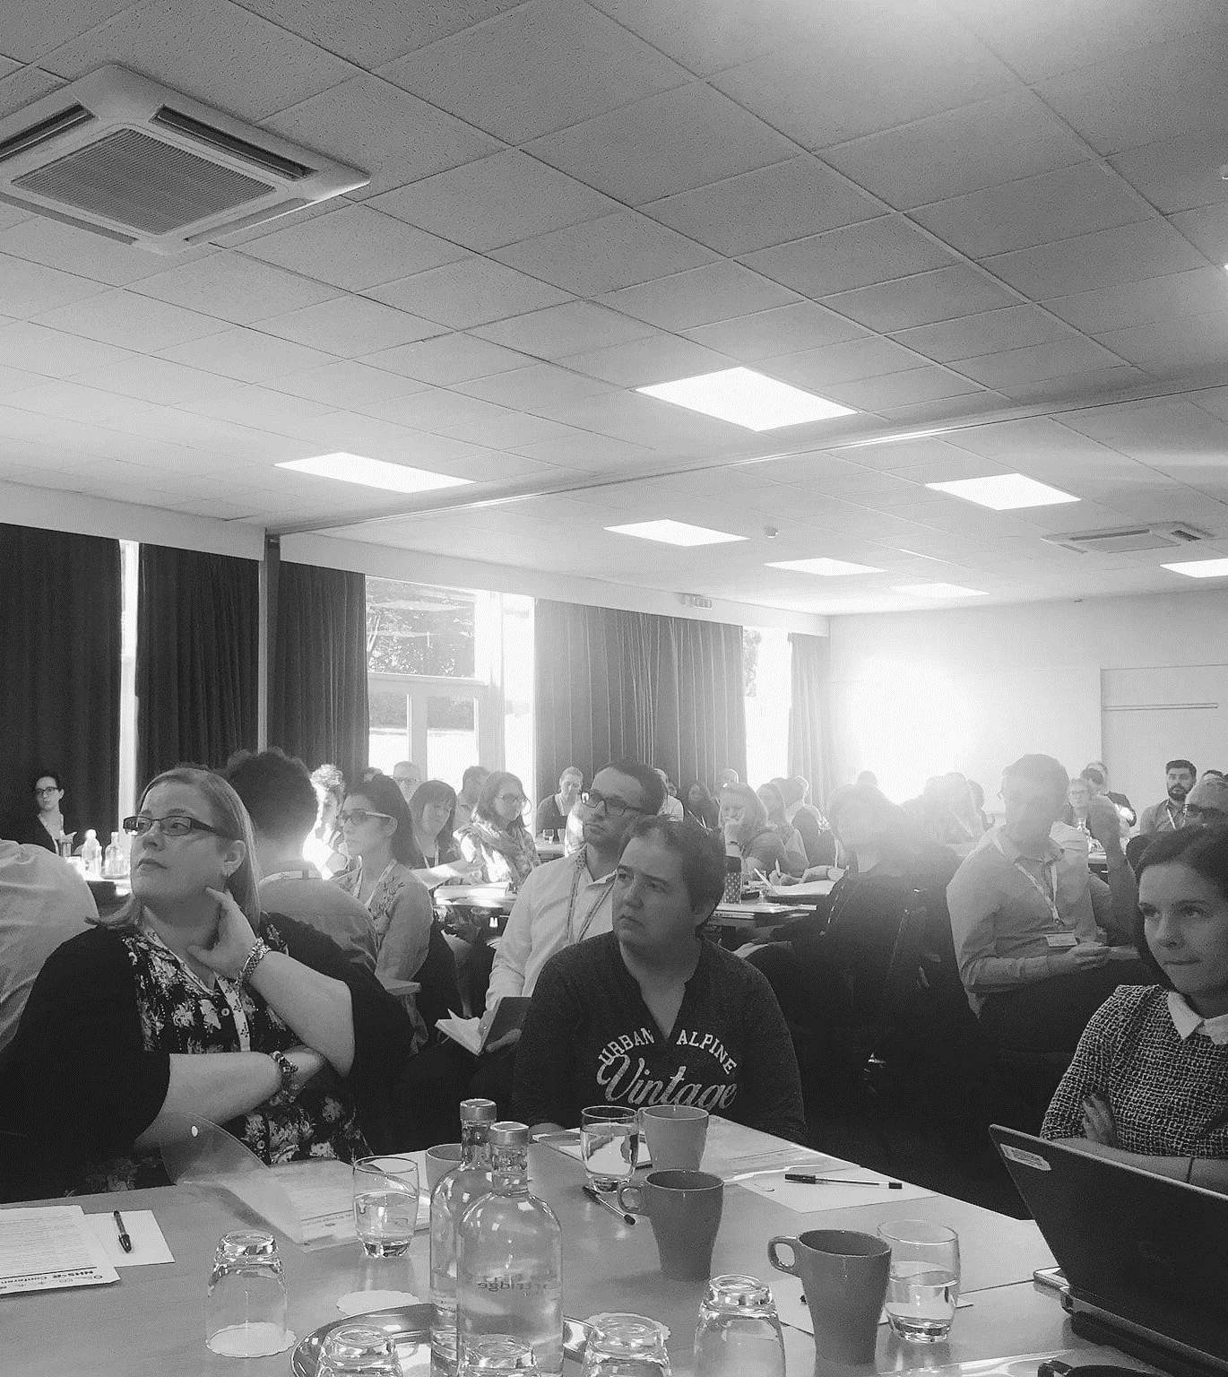
Training as a solution
Training started when NHS-R Community started, in 2018, with the introduction to R and R Studio. It was a 3 day workshop course that was delivered in-person. That course was then passed onto a train the trainer course for people around the community to train people in their own areas and, hopefully, train others who could travel to them.
The course has now been developed from pdf slides to the more accessible and version controlled {xaringan} slides. Some have also been updated on more recent graph examples and an additional module for SQL connections. These are hosted on GitHub for people to use as slides and the code that generates those slides.

Slide 15
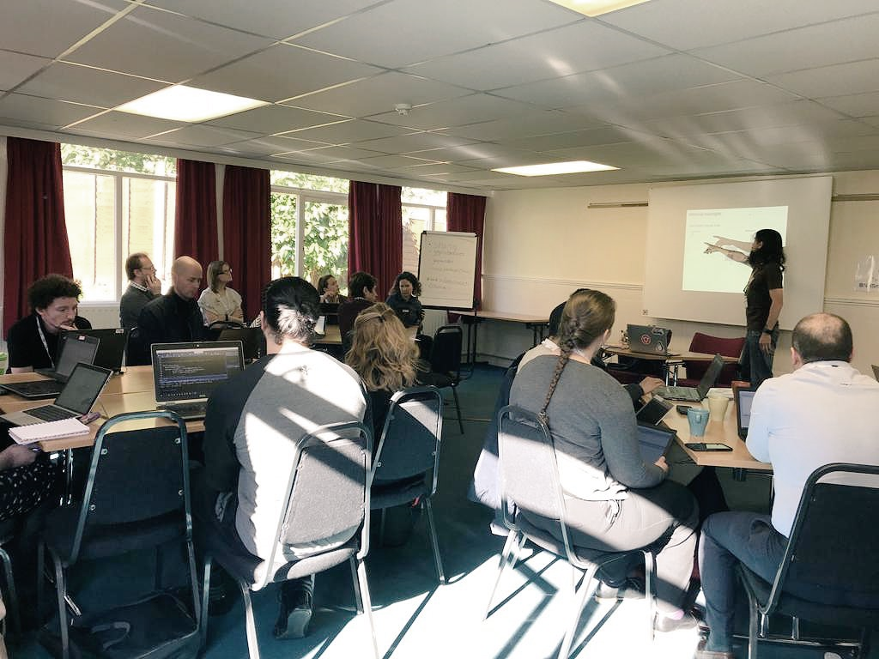
Training as a solution
The future of the training provision will be a development of the introduction to R and R Studio course into a package {NHSRtraining} which can complement, reinforce or stand alone to the delivered training. We’ve also had Shiny training developed and delivered to the community and finally an Rmarkdown workshop was developed and first delivered at this year’s conference. Both Shiny and Rmarkdown are hoped to be delivered by other members of the community using Train the Trainer type workshops.
Training is integral to what we can do as a community as people are at varying levels of R knowledge who can benefit from the training or who can improve their own learning by delivering the courses. R is about collaboration and community and training underpins this. We connect with each other, build those relationships and learn.

Slide 16



NHS-R package and solution mentorship

Slide 17
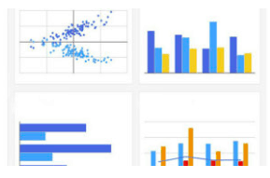

Join the R solution club!
“The best solutions are often simple, yet unexpected, and created by passionate and devoted R aficionados”

